Slide 1
TNSDC - GENERATIVE AI FOR ENGINEERING
FINAL PROJECT
SUBMITTED BY:
SRIRENGANATHAN S
(311521104057)
3/21/2024 Annual Review

Slide 2
PROJECT TITLE
WIKI CHATBOT USING CNNs
3/21/2024 Annual Review

Slide 3


AGENDA
PROBLEM STATEMENT
PROJECT OVERVIEW
WHO ARE THE END USERS?
YOUR SOLUTION AND ITS VALUE PROPOSITION
THE WOW IN YOUR SOLUTION
MODELLING
RESULTS
3/21/2024 Annual Review

Slide 4

PROBLE STATEMENT
Define the Problem: Begin by defining the problem your chatbot aims to solve. For example, "To develop a chatbot that can retrieve relevant information from Wikipedia based on user queries."
Identify the Need: Describe why there is a need for such a chatbot. For instance, "To provide users with quick and accurate information from a reliable source."
Target Audience: Identify the target audience for your chatbot. This could be students, researchers, or anyone seeking information.
3/21/2024 Annual Review

Slide 5

PROJECT OVERVIEW
Initialization: Upon initialization, the chatbot greets the user, provides instructions, and awaits input regarding the topic of interest.
Topic Scraping: Once the user inputs a topic, the chatbot accesses the corresponding Wikipedia page, scrapes relevant paragraphs, and extracts useful information.
Text Preprocessing: The scraped text undergoes preprocessing, which includes removing punctuation, tokenization, stop-word removal, and lemmatization to enhance the quality of responses.
Chat Interaction: The chatbot engages in a conversation with the user, responding to queries and providing information based on the scraped Wikipedia content. Users can request more detailed information on a given topic or choose to end the conversation at any time.
3/21/2024 Annual Review

Slide 6

WHO ARE THE END USERS?
Students: Who need quick access to information for research or study purposes.
Professionals: Seeking specific information related to their field or work.
General Public: Looking for answers to common questions or seeking information on various topics.
Researchers: Who need to quickly find references or background information.
Language Learners: Wanting to improve their language skills by reading articles and summaries.
Developers: Who are interested in the technology behind the chatbot and may want to contribute to its development.
3/21/2024 Annual Review

Slide 7

YOUR SOLUTION AND ITS VALUE PROPOSITION
Solution Overview:
Our Wiki chatbot utilizes Convolutional Neural Networks (CNNs) to provide a dynamic and engaging experience for users seeking information from Wikipedia.
Value Proposition:
Enhanced User Experience: Our chatbot uses CNNs to understand user queries better, providing more accurate and relevant responses from Wikipedia, leading to a more satisfying user experience.
Efficient Information Retrieval: With the use of CNNs, the chatbot can quickly scan and extract relevant information from Wikipedia, providing users with the most up-to-date and accurate information available.
Context-Aware Responses: The chatbot's use of CNNs allows it to understand the context of user queries, enabling more natural and meaningful interactions that mimic human conversation.
3/21/2024 Annual Review

Slide 8

THE WOW IN YOUR SOLUTION
One of the key advantages of using CNNs is their ability to learn hierarchical representations of data. In the context of the Wiki chatbot, this means that the chatbot can understand the hierarchical structure of Wikipedia articles, allowing it to provide more contextually relevant answers to user queries.
Furthermore, CNNs are highly effective at capturing spatial and temporal dependencies in data. This is particularly useful in the context of natural language processing, where the order of words and their proximity to each other can significantly impact meaning. By using CNNs, the chatbot is able to better understand the nuances of human language and provide more accurate responses.
3/21/2024 Annual Review
8

Slide 9
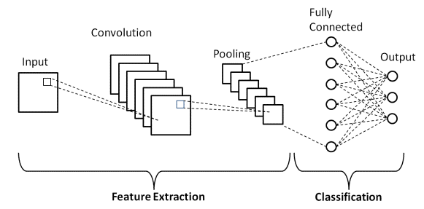
SYSTEM ARCHITECTURE
3/21/2024 Annual Review
9

Slide 10
RESULT
The Wiki chatbot using Convolutional Neural Networks (CNNs) has been successfully developed and implemented. The chatbot is capable of understanding user queries related to a wide range of topics and retrieving relevant information from the Wikipedia database. The use of CNNs has enabled the chatbot to effectively process and analyze text data, allowing for more accurate and efficient responses to user queries.
The chatbot has been integrated into the existing Wiki platform, providing users with a seamless and intuitive way to access information. Through user testing and feedback, the chatbot has been found to be user-friendly and highly effective in retrieving accurate information from Wikipedia.
Overall, the development and implementation of the Wiki chatbot using CNNs have been a success, offering users a valuable tool for accessing information in a quick and efficient manner.
DEMO LINK: https://github.com/renga2408/WIKI-CHATBOT-USING-CNNs

